Slide 1
Database management system
Lecture 03

Slide 2
Objectives of Three-Level Architecture ANSI SPARC
It was proposed by ANSI SPARC
Different users want different views of same data. Therefore All users should be able to access same data but have a different customized view e.g employees information
A user’s view is immune to changes made in other views
Users should not need to know physical database storage details
Notes:
Bullet 2

Slide 3
Objectives of Three-Level Architecture..
DBA should be able to change database storage structures without affecting the users’ views i.e. ensure program data independence
Internal structure of database should be unaffected by changes to physical aspects of storage e.g physical devices
DBA has the authority and should be able to change conceptual structure of database without affecting all users

Slide 4
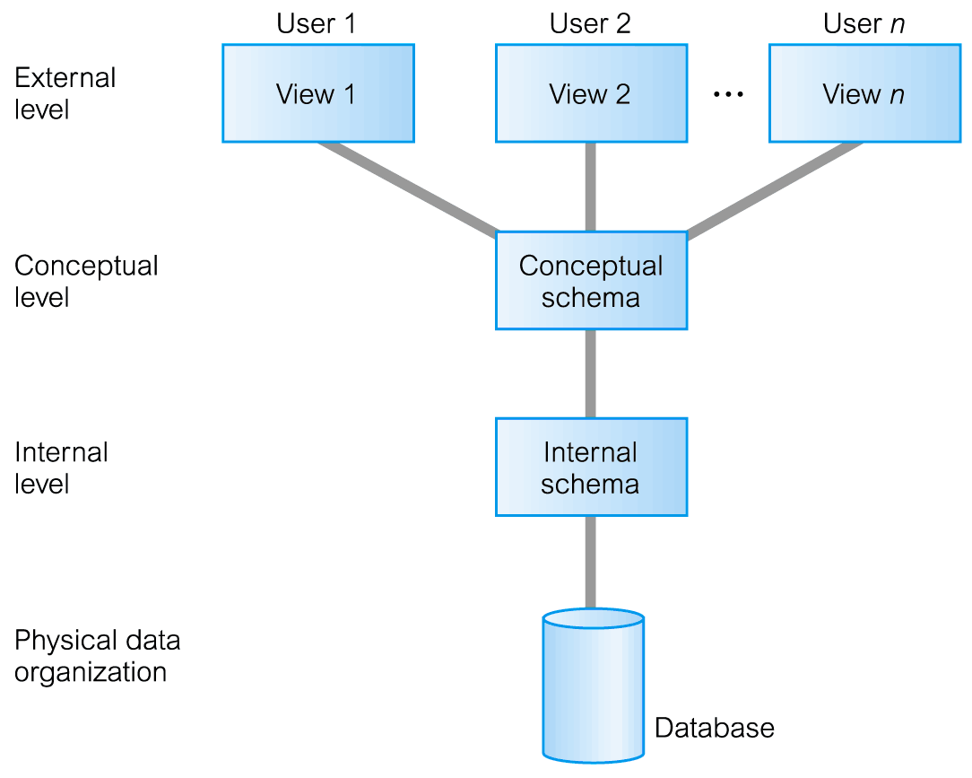
ANSI-SPARC Three-Level Architecture
The way users perceive the data is called external level
Conceptual level provides mapping between internal and external levels
The way the DBMS and operating system perceive the data is internal level, where data is stored using data structures and file organizations

Slide 5
ANSI-SPARC Three-Level Architecture..
External Level
Users’ view of the database and describes that part of database that is relevant to a particular user
each user has a view of real world data represented in a form familiar for that user.
Different views may have different representation of same data
for e.g one user may view dates in the form of (day,month year) while another may view dates as (year,month,day)

Slide 6
ANSI-SPARC Three-Level Architecture..
External Level
some views might include derived or calculated data i.e data not stored as such in database but created when needed
E.g we may wish to calculate the age of an employee.
however it is unlikely that ages would be stored, as this data would have to be updated daily.
instead employee date of birth would be stored and age would be calculated by DBMS when referenced
different date formats, age derived from DOB etc.)

Slide 7
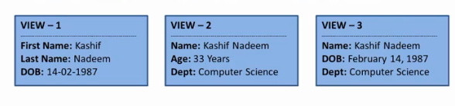
ANSI-SPARC Three-Level Architecture..
Example of External Level view

Slide 8
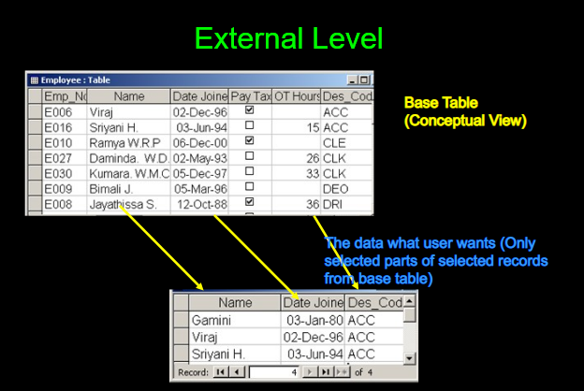
Example of external level

Slide 9
ANSI-SPARC Three-Level Architecture..
Conceptual Level
Community view of the database
This level describes what data is stored in database and relationships among the data
The middle level in the three level architecture is conceptual level
This level contains the logical structure of the entire database as seen by the DBA
It is a complete view of the data requirements of the organization that is independent of any storage considerations.

Slide 10
Conceptual level
The conceptual level represents all entities their attributes, and their relationships; the constraints on the data, semantic information about the data, security and integrity information.
The conceptual level supports each external view, in that any data available to a user must be contained in, or derivable from, the conceptual level. However, this level must not contain any storage-dependent details.
For instance, the description of an entity should contain only data types of attributes (for example, integer, real, character) and their length (such as the maximum number of digits or characters), but not any storage considerations, such as the number of bytes occupied.

Slide 11
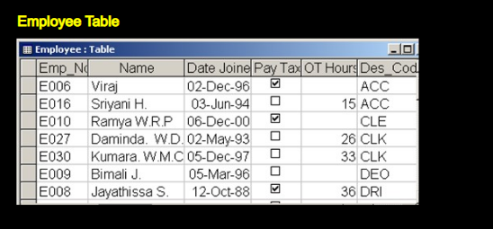
Conceptual level

Slide 12
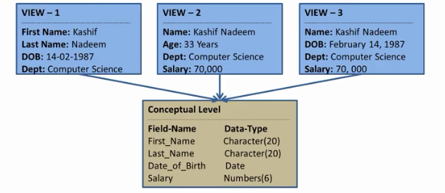
conceptual level

Slide 13
Internal level
The physical representation of the database on the computer. This level describes how the data is stored in the database.
The internal level covers the physical implementation of the database to achieve optimal runtime performance and storage space utilization.
It covers the data structures and file organizations used to store data on storage devices.

Slide 14
Internal level
The internal level is concerned with following things :
storage space allocation for data and indexes;
record descriptions for storage (with stored sizes for data items);
record placement;
data compression and data encryption techniques
Below the internal level there is a physical level that may be managed by the operating system under the direction of the DBMS.

Slide 15
Internal level
However, the functions of the DBMS and the operating system at the physical level are not clear-cut and vary from system to system.
The physical level below the DBMS consists of items that only the operating system knows,
such as exactly how the sequencing is implemented and whether the fields of internal records are stored as contiguous bytes on the disk.

Slide 16
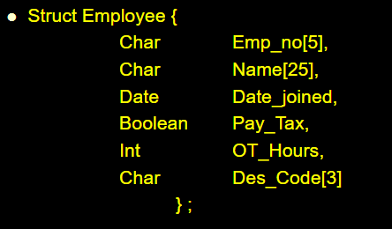
Internal level

Slide 17
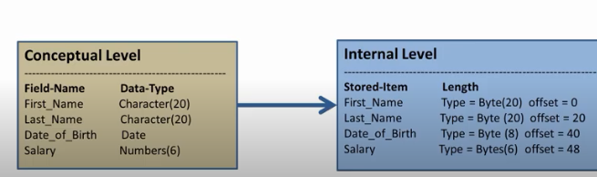
Example of conceptual and internal level

Slide 18
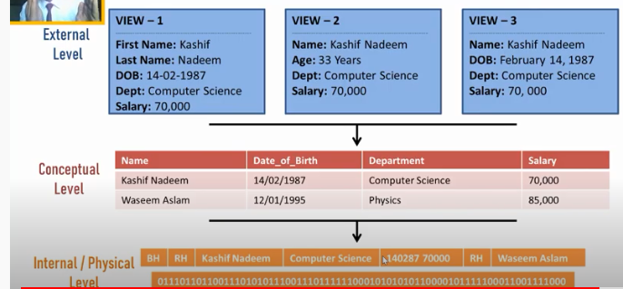
Three level architecture

Slide 19
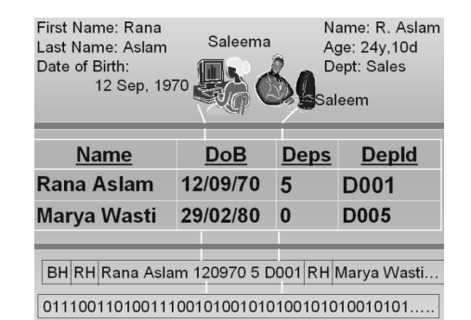
Example of three level architecture

Slide 20
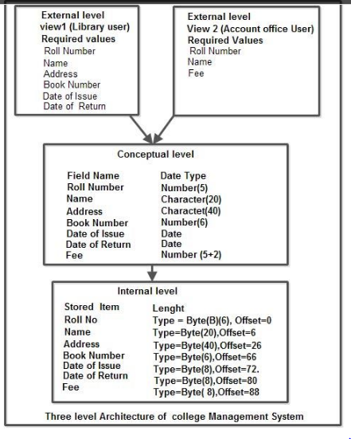
Three level architecture of college management system

Slide 21
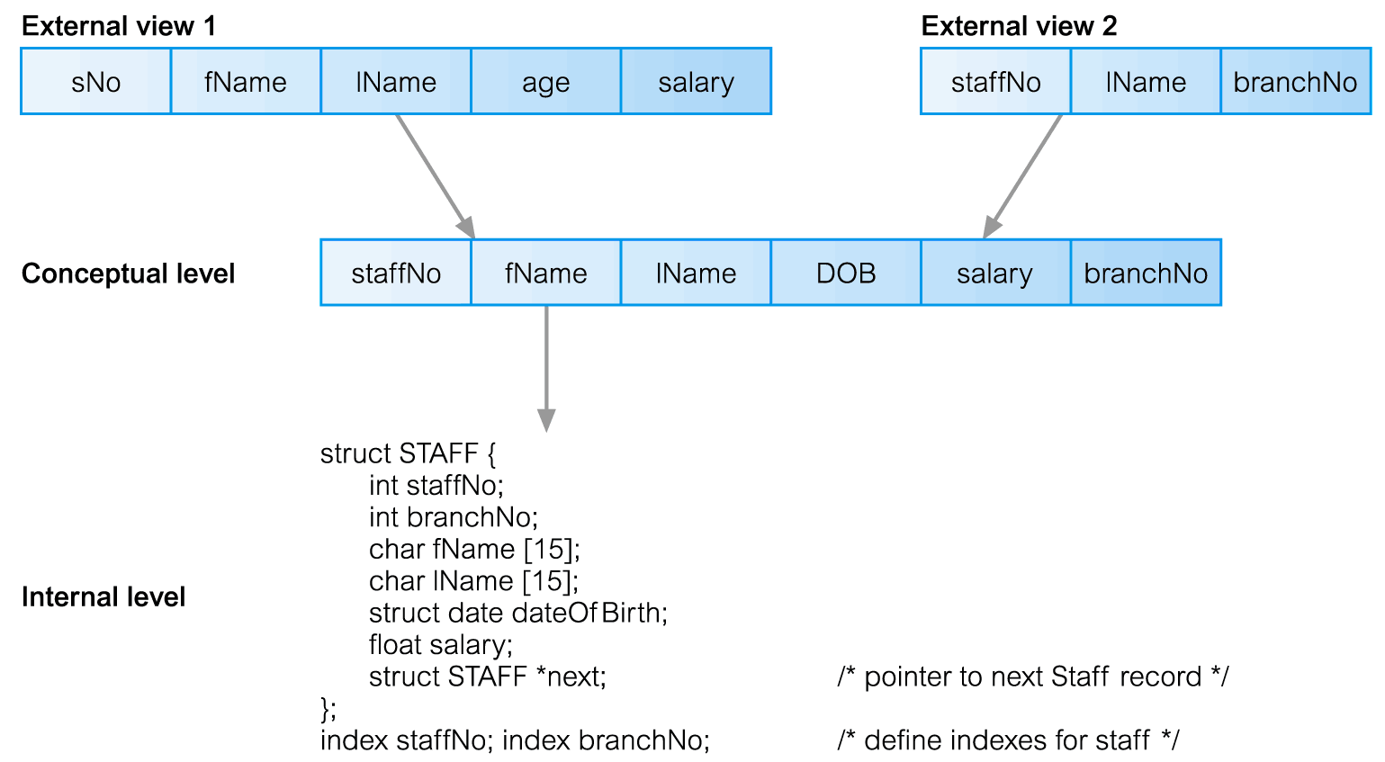
Differences between Three Levels of ANSI-SPARC Architecture

Slide 22
Differences between Three Levels of ANSI-SPARC Architecture
Two different external views of staff details exist:
one consisting of a staff number (sNo), first name (fName), last name (IName), age, and salary;
a second consisting of a staff number (staffNo), last name (IName), and the number of the branch the member of staff works at (branchNo).
These external views are merged into one conceptual view.
In this merging process, the major difference is that the age field has been changed into a date of birth field, DOB

Slide 23
Differences between Three Levels of ANSI-SPARC Architecture
The DBMS maintains the external/conceptual mapping;
for example, it maps the sNo field of the first external view to the staffNo field of the conceptual record.
The conceptual level is then mapped to the internal level, which contains a physical description of the structure for the conceptual record.
At this level, we see a definition of the structure in a high-level language.
The structure contains a pointer, next, which allows the list of staff records to be physically linked together to form a chain.
Note that the order of fields at the internal level is different from that at the conceptual level. Again, the DBMS maintains the conceptual/ internal mapping.

Slide 24
Differences between Three Levels of ANSI-SPARC Architecture
It is important to distinguish between the description of the database and the database itself.
The description of the database is the database schema.
The schema is specified during the database design process and is not expected to change frequently. However, the actual data in the database may change frequently;
for example, schema changes every time we insert details of a new member of staff or a new property.

Slide 25
Schemas, Mappings, and Instances
There are three different types of schema in the database and these are defined according to three-level architecture
At the highest level, we have multiple external schemas (also called subschemas) that correspond to different views of the data
At the conceptual level, we have the conceptual schema, which describes all the entities, attributes, and relationships together with integrity constraints.
At the lowest level of abstraction we have the internal schema, which is a complete description of the definitions of stored records, the methods of representation, the data fields, and the indexes and storage structures used.
There is only one conceptual schema and one internal schema per database.

Slide 26
Schemas, Mappings, and Instances
The DBMS is responsible for mapping between these three types of schema and must also check the schemas for consistency;
In other words, the DBMS must confirm that each external schema is derivable from the conceptual schema, and it must use the information in the conceptual schema to map between each external schema and the internal schema.

Slide 27
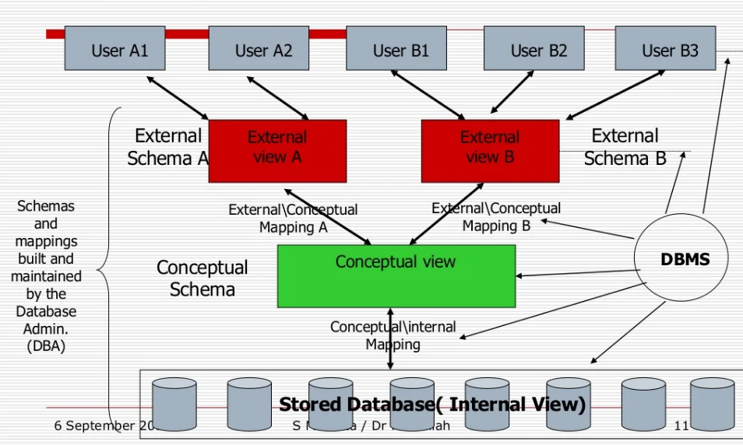
Mappings
Mapping defines the correspondence between the
external mapping and conceptual mapping
Conceptual mapping and internal mapping

Slide 28
External/ conceptual mapping
External schema is related to conceptual schema by external/conceptual mapping
Defines the correspondence between a particular external view and conceptual view
Many conceptual fields can form one external view etc

Slide 29
Conceptual /internal mapping
conceptual schema is related to internal schema by conceptual/internal mapping
Defines the correspondence between conceptual and internal schema
specifies how conceptual records are represented into internal level
if structure of DB is changed
Conceptual/internal mapping is changed accordingly
DBA makes these changes
effects of such changes are isolated between two schemas

Slide 30
Mapping-data independence
Logical data Independence(Provided by external/conceptual mapping)
1. Ability to modify conceptual schema without changing
External views
Application programs
2. Changes to conceptual schema may be necessary
Whenever the logical structure of database changes
Due to changed objectives
Examples
Adding a data item to schema
Adding project table to suppliers part database

Slide 31
Mapping-data independence
Physical data Independence(Provided by conceptual/internal mapping)
1. Ability to modify internal or physical schema without changing
Conceptual schema
Application programs
2. Changes to physical schema may be necessary
Improve performance of retrieval and update
3. Achieving logical data independence is more difficult than physical data independence
because application programs heavily rely on logical structure of the data they access

Slide 32
Logical Data Independence example
For example, the hospital billing department could add a column to the database table for each patient’s insurance policy number.
Having logical data independence means that the view of the food services department and other users are not changed even though modifications were made to the conceptual level.

Slide 33
Physical Data Independence
The patient database in our example could be moved from drive C to drive D, but the conceptual schema and external views remain unchanged because of physical data independence.

Slide 34
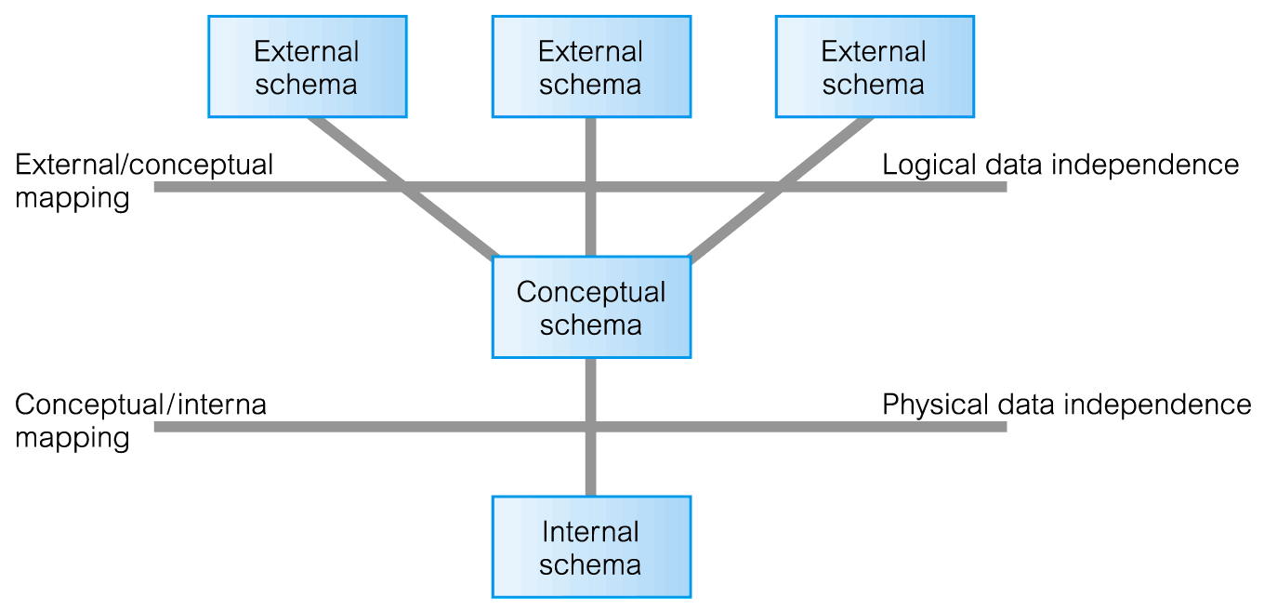
Data Independence and the ANSI-SPARC Three-Level Architecture

